Slide 1
Agile in Action
From Principles to Products
Summer 2021
Notes:
1
1
Check distro statement before using:
DISTRIBUTION STATEMENT A. Approved for pubic release: distribution is unlimited.
This material is based upon work supported under Air Force Contract No. FA8721-05-C-0002 and/or FA8702-15-D-0001. Any opinions, findings, conclusions or recommendations expressed in this material are those of the author(s) and do not necessarily reflect the views of the U.S. Air Force.
© 2021 Massachusetts Institute of Technology.
Delivered to the U.S. Government with Unlimited Rights, as defined in DFARS Part 252.227-7013 or 7014 (Feb 2014). Notwithstanding any copyright notice, U.S. Government rights in this work are defined by DFARS 252.227-7013 or DFARS 252.227-7014 as detailed above. Use of this work other than as specifically authorized by the U.S. Government may violate any copyrights that exist in this work.

Slide 2
Today’s Topics
Kanban and Scrum Review
Kanban Best Practices
Scrum In-Depth
Scrum Ceremonies
Scrum Roles
Scrum Best Practices
Project Management
Understanding Workflow
Code Review
User Stories
Time Estimation
Wrap-up

Slide 3
Agile Overview
An “iterative approach to project management and software development”
Keyword: Iterative
Avoid developing all features and testing at the very end
Resolve roadblocks in development while still being productive in other aspects of a project
Note that Agile ≠ Fast
Recall values of the Agile Manifesto
Individuals and interactions
Working software
Customer collaboration
Responding to change
Notes:
Note: Improved development speed is a result of good Agile practices, not the sole goal

Slide 4
Agile Frameworks
The Agile approach requires a framework
Frameworks build off the themes described in the Manifesto
Allow teams to act upon the more abstract ideals in the Manifesto
You will often hear about the Scrum and Kanban frameworks

Slide 5
Kanban and Scrum
Kanban
Objectives: Minimize bottlenecks in project, consistently work at capacity
Tools: Cards, Boards, Work-in-Progress Limits
Scrum
Objectives: Reflection for self-improvement, Keep Team Engaged
Tools: Sprints, Daily Scrum, Retrospectives, Backlogs

Slide 6
Kanban

Slide 7
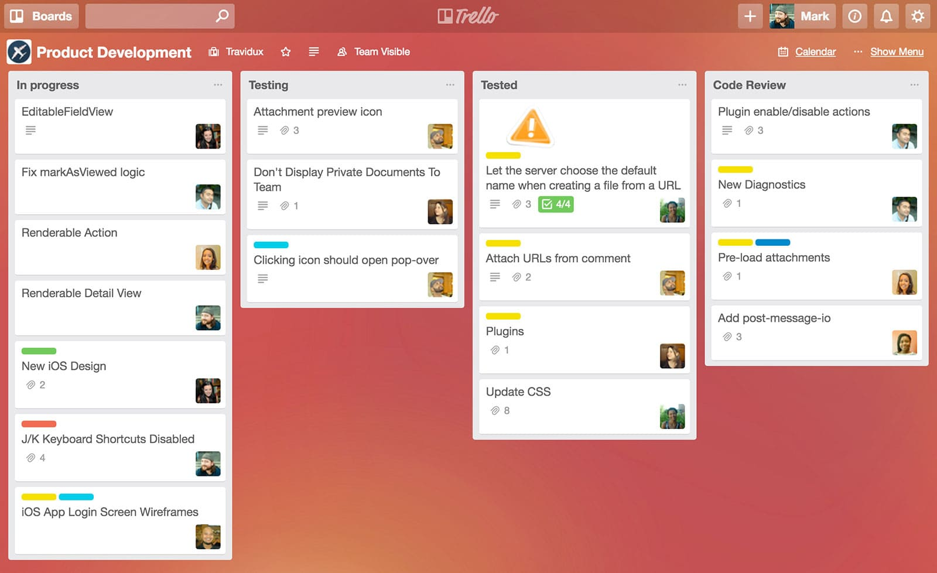
Kanban Workflow: Boards and Cards
“Flow” visualized using boards and cards
Boards categorize tasks by their completion status
Highlight important details with visual cues
Track progress, note amount of cards per board
Notes:
Typically, the categories are To Do, In Progress, Code Review, Done

Slide 8
Kanban Board Best Practices
Avoid crowding a column with cards
Harder to navigate
Lose quick updates on task status
Exception: Backlog
Don’t spread tasks across too many boards
Becomes unwieldy and unfocused
Lose ability to see all relevant tasks at once
Color coding is important
Can be used for assigning teams members, urgency, category
Much like this PowerPoint slide, minimize the text!

Slide 9
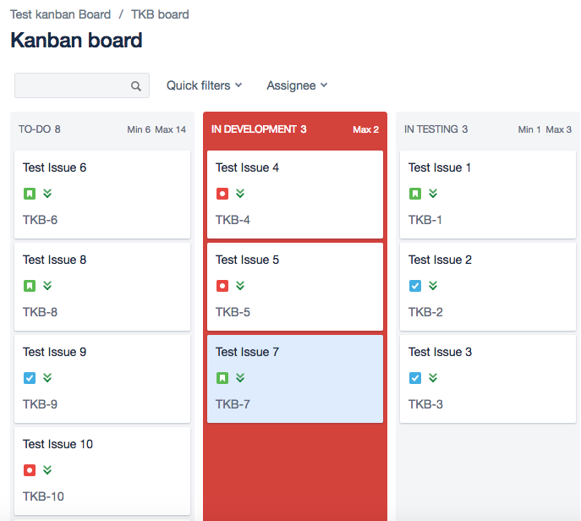
Kanban Workflow: WIP Limits
Work-in-progress curb tendency to take on too much at once
Sets limit on number of tasks in a particular column
E.g. no more than 2 tasks can be under testing at a time
Counterintuitive?
Recall that multitasking slows performance
Improves speed of workflow by encouraging focus

Slide 10
Scrum

Slide 11
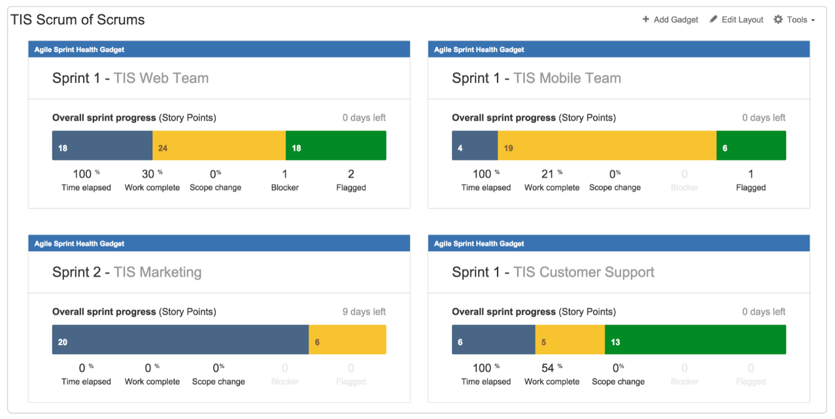
Sprints
Fundamental to Scrum framework
Short periods (7-14 days) where teams work to meet an end goal
Note that Scrum ≠ Fast
Focus on incremental development
Each sprint contains four major “ceremonies”
Sprint planning
Daily scrum/Standup
Sprint Reviews
Sprint Retrospection

Slide 12
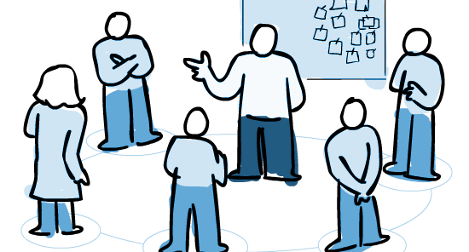
Sprint Planning
Team meets to discuss achievable goals within sprint time-frame
Product Backlog (e.g. contains bug fixes to be done, phases of features)
Key objective of a Sprint Planning ceremony is to decide on a Sprint Goal
Topic One: What can be done this Sprint?
Topic Two: how will the chosen work get done?
For your purposes, ceremony should be concise but comprehensive

Slide 13
Daily Scrum or Standup
Daily 15-min event
Address progress on sprint in a constructive manner
Good questions for individuals in standups
What did I work on yesterday?
What am I working on today?
What issues are blocking me?
Key to identifying bottlenecks in development during a sprint
This is not a test
Simply a moment for transparency between teammates on progress

Slide 14
Sprint Review
Working tirelessly can be mentally taxing
Designed to incorporate a positive atmosphere
Gives a sense of completion to the sprint
Informal demos, trying new features, etc.
“Sharing in success is an important part of building an agile team.”
Success comes from achieving your Sprint Goal
Clearly define the Goal
Clearly define when you’ve completed it
Avoid the “One more thing” mentality
This is not a test

Slide 15
Sprint Retrospection
A deeper dive reflecting on the sprint
A moment for improvement
Again, note the positive atmosphere
Need to keep morale up, esp. during a feature-heavy project
Discussion points:
What went well in the sprint?
What could be improved?
What will we commit to improve in the next sprint?
https://dzone.com/articles/11-ideas-to-spice-up-your-retrospective

Slide 16
Scrum Roles

Slide 17
Product Owner
Identifies the deliverables for each sprint
Keyword: Vision
Understand what customer/end-user needs in the product
Understand how to communicate those needs to Development Team
Understand how needs of other stakeholders influence vision of product
Managing Product Backlog
“everything that is known to be needed in the product” phrased as needs from the end-users
Should know what to prioritize in Backlog

Slide 18
Development Team
Not just software developers, include UI/UX, writers, etc.
Treat as a single unit, don’t subdivide
May have specialists within the Team, but must contribute to the whole group
Self-organizing, choose their own priorities from Backlog
Size of the team must strike a balance between having an adequate collective skillset and being manageable for self-organization

Slide 19
Scrum Master
Scrum Masters are “responsible for promoting and supporting Scrum”
Ensure that the Scrum framework is upheld throughout project
Interactions with Development Team:
Coach Development Team to self-organize and become a functional single unit
Facilitate Scrum ceremonies
Interactions with Product Owners:
Explicitly define the goals and scope of a sprint, as well as the project as a whole
Finding ways to improve Product Backlog management

Slide 20
Scrum Best Practices
Keep it concise with proper planning
Be timely!
Stick to an agenda during sprints and their ceremonies
Entire point of sprints is to make development manageable
Break down tasks
Track your progress
Don’t give new ideas during Scrum ceremonies
Detracts from Goal of a sprint
Prevents clear updates on what’s been accomplished

Slide 21

Kanban vs. Scrum?
It’s not versus, but and/or
Take the best of both!
Hybrid models use tools from one framework for use into the other

Slide 22
Project Management

Slide 23
Workflow Redux
Define: the process used to complete work
A good workflow allows a team:
To clearly identify tasks
Identify the completion status of those tasks via states
Track issues and bugs in development
At a minimum, the team’s workflow should denote these states:
To Do
In Progress
Code Review / In Review
Done
To optimize the workflow, look at what categories have the largest backlog of incomplete tasks, a sign of a bottleneck

Slide 24
Code Review
Goal: Improve code quality as a team
“An ounce of prevention is worth a pound of cure”
Catching bugs early prevent downstream effects that could upend a project
As a collaborative effort, code reviews
Promote collaboration and transparency
Help the reviewed become better reviewers in the process (self-sustaining)
Do not exclude any one developer. No one is exempt from review
Git Workflow is highly relevant to code review
Branch pull requests should always have a second reviewer before merging
While reviewers will often catch flaws in your cod, it is not personal

Slide 25
User Stories
The entirety of your project is more than the sum of its code!
Remember, you have customers!
Rob’s Week 3 Requirements Lecture. A user story:
Denotes tasks from the user’s perspective: “As a [persona], I [want to], [so that].”
Focuses on what must be accomplished, not how to do it
Answering “how comes” with collaboration
Break it down
Identify goals
Notes:
(“When the app starts, a screen with my todo list appears”)

Slide 26
Time is Relative: Estimation
Estimates define the effort needed for a task
This included the completion AND evaluation
If you don’t test it, do you know if it’s really complete?
The Project Management Institute states this is the major mistake made in estimating the time needed to achieve goals in a project
Development Team must communicate with Product Owner about the effort needed for a task
In order to properly estimate the time needed, identify the requirements that break down an objective
E.g. when making a sandwich, what are the requirements?

Slide 27
Tying back to ZGame
How does this apply?

Slide 28
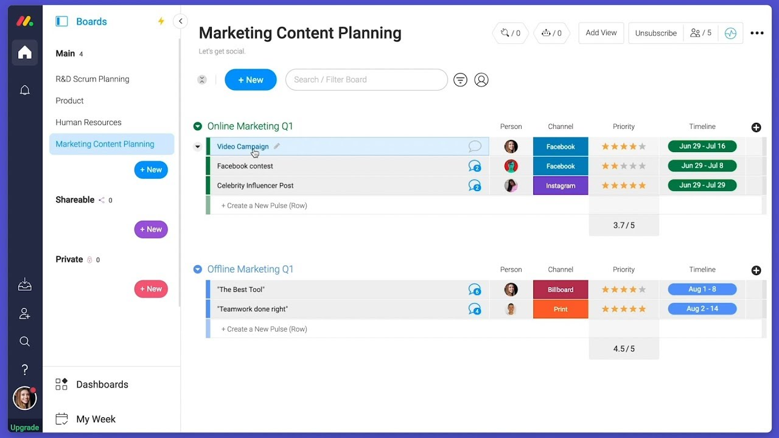
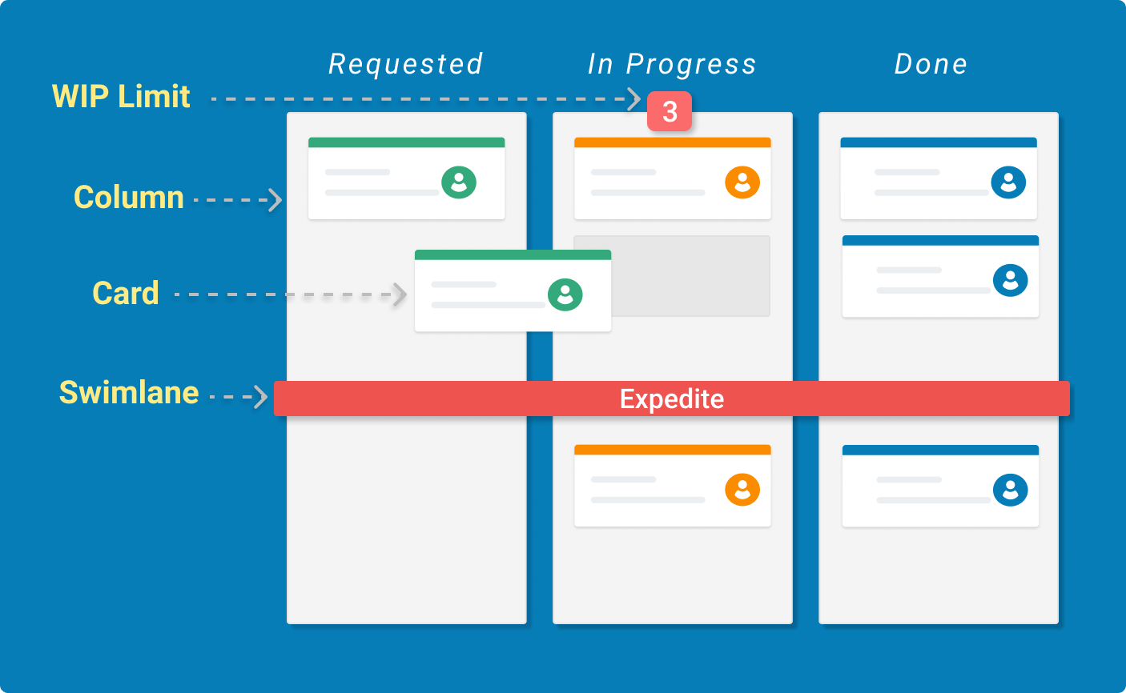
Tying back
Use Tools for Agile Frameworks (Trello, GitHub issues, Monday, etc.) appropriately
If you need multiple Trello boards to stay organized and maintain structure, do it
Don’t overcrowd boards!
Have a Backlog column
Remember the customer!
Your project will be demoed to others
Clearly describe the requirements of your mod
Keep communication open, polite, constructive, and productive

Slide 29
Resources
https://www.atlassian.com/agile
https://www.scrumguides.org/scrum-guide.html
https://medium.com/palantir/code-review-best-practices-19e02780015f
https://www.scrum.org/resources/
https://blog.fullstory.com/what-we-learned-from-google-code-reviews-arent-just-for-catching-bugs/
https://www.pmi.org/learning/library/five-keys-accurate-project-estimating-6927

Slide 30


